Slide 1
PhonePe Pulse: Transaction & User Insights (2018–2024)
An Interactive Data Analytics & Visualization Project
J. SUMATHI GURUNATHAN

Slide 2
Objective:
Analyzing the vast PhonePe Pulse dataset to understand digital payment dynamics across India.
Key Goals:
1.Extract and clean JSON data from the PhonePe Pulse GitHub.
2.Build a robust SQL Database for high-speed querying.
3.Create an interactive Streamlit Dashboard for real-time business insights.

Slide 3
Technical Stack
Language: Python (Pandas for data cleaning, OS/JSON for parsing).
Database: PostgreSQL (storage for aggregated and map data).
Visualization: Plotly Express (Interactive Choropleth Maps and Charts). Plotly and GeoJSON for the mapping.
Web Framework: Streamlit (User interface and dashboard hosting).
Environment: VS Code and GitHub.

Slide 4
Geospatial Analysis (India 2D Map)
Key Insight: The map immediately identifies "Dark Zones" (high activity) in the South and West, and "Light Zones" (growth opportunities) in Central and North-East India.
Feature: Interactive Choropleth Map of India.
Purpose: To visualize the "Density of Transactions" across different states and districts.
How it works:
  Linked SQL data with a GeoJSON file of India.
  Used Plotly Express (px.choropleth) to color-code states based on transaction amounts.
Key Insight: The map immediately identifies "Dark Zones" (high activity) in the South and West, and "Light Zones" (growth opportunities) in Central and North-East India.

Slide 5
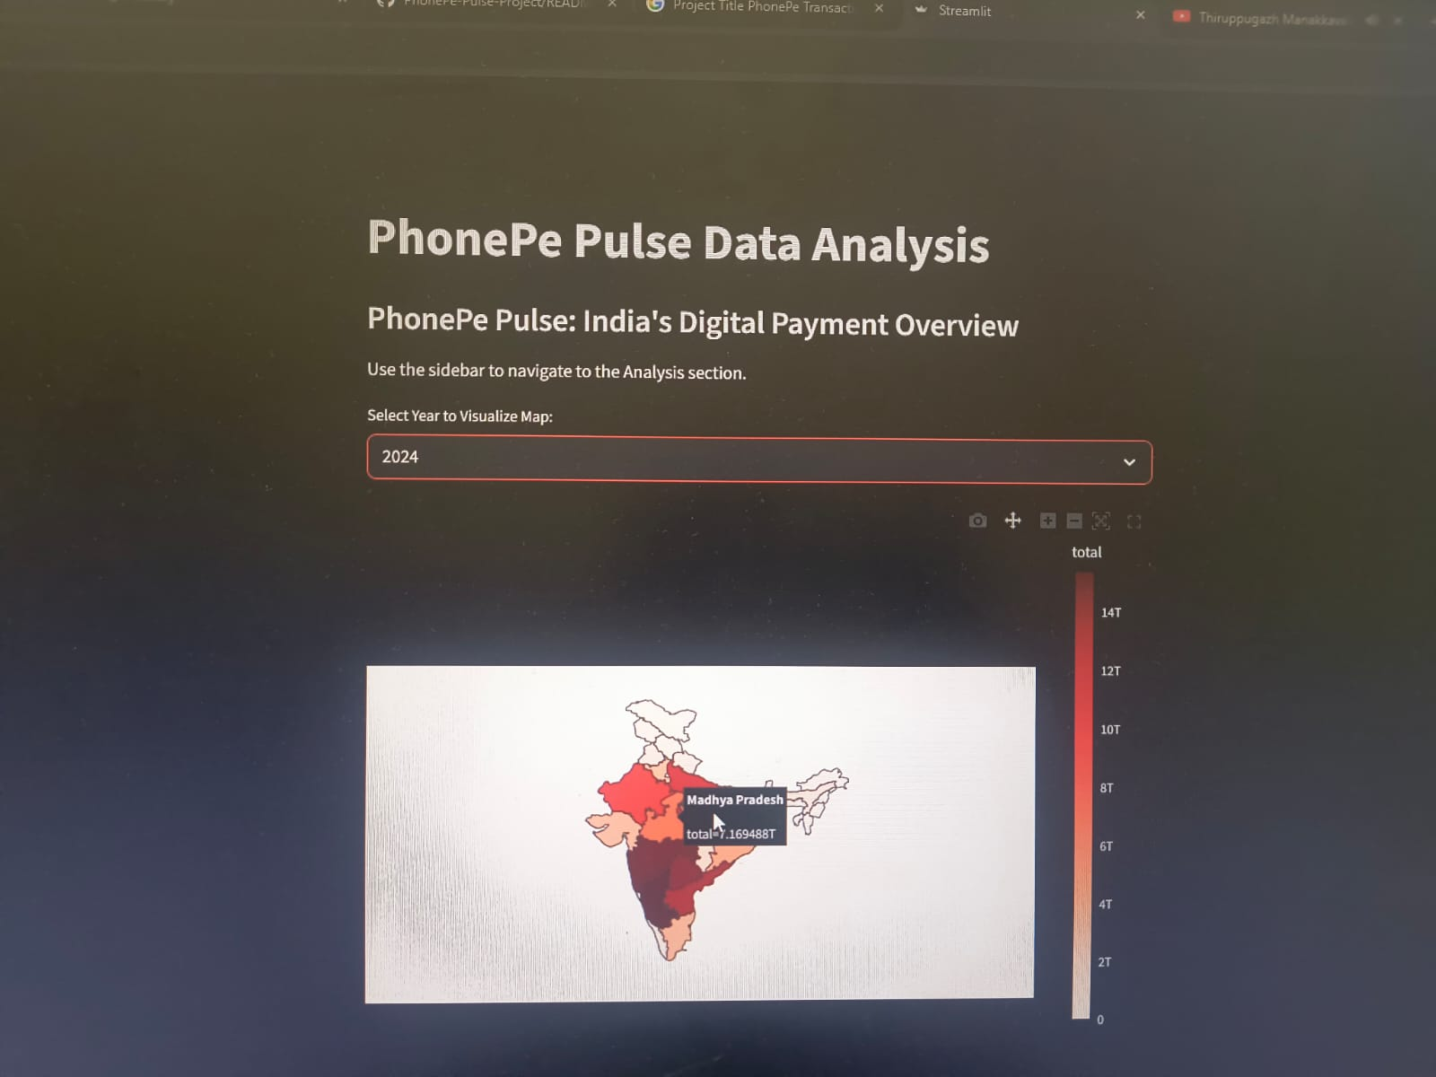
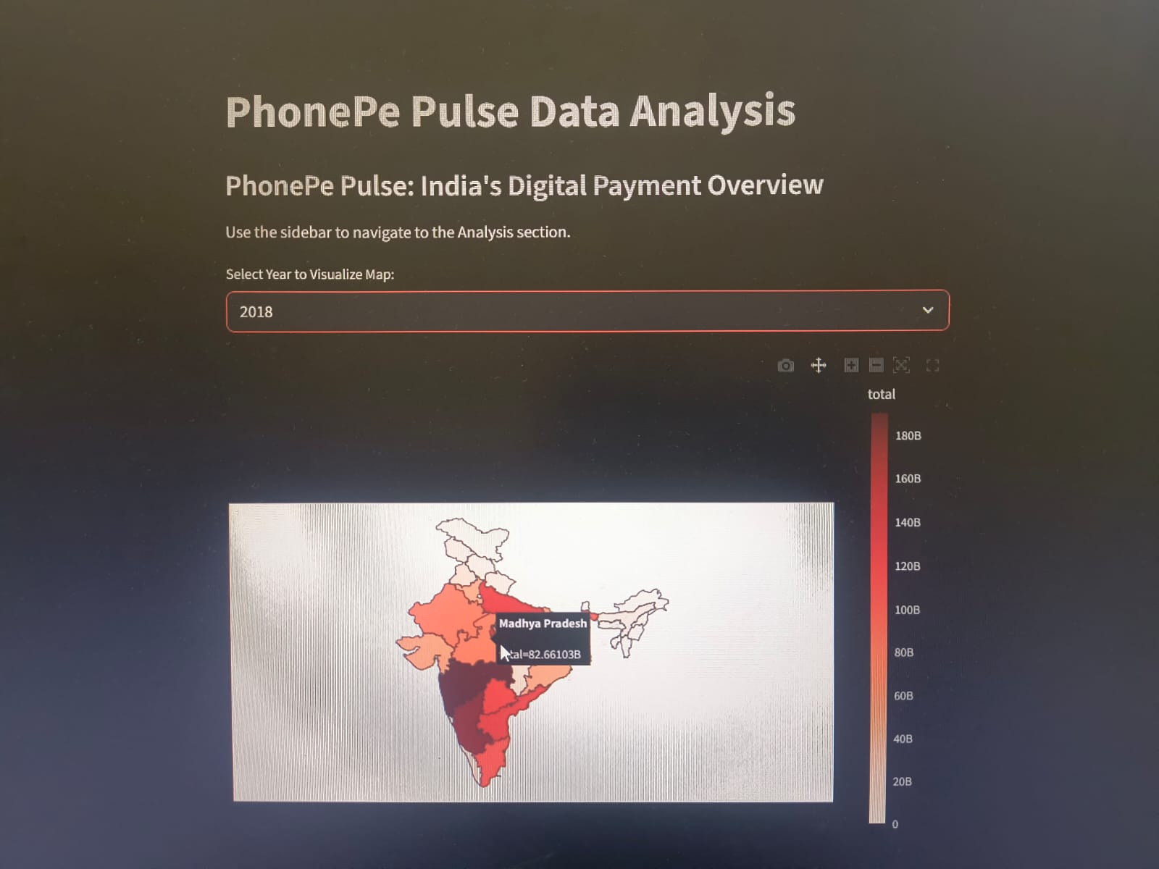
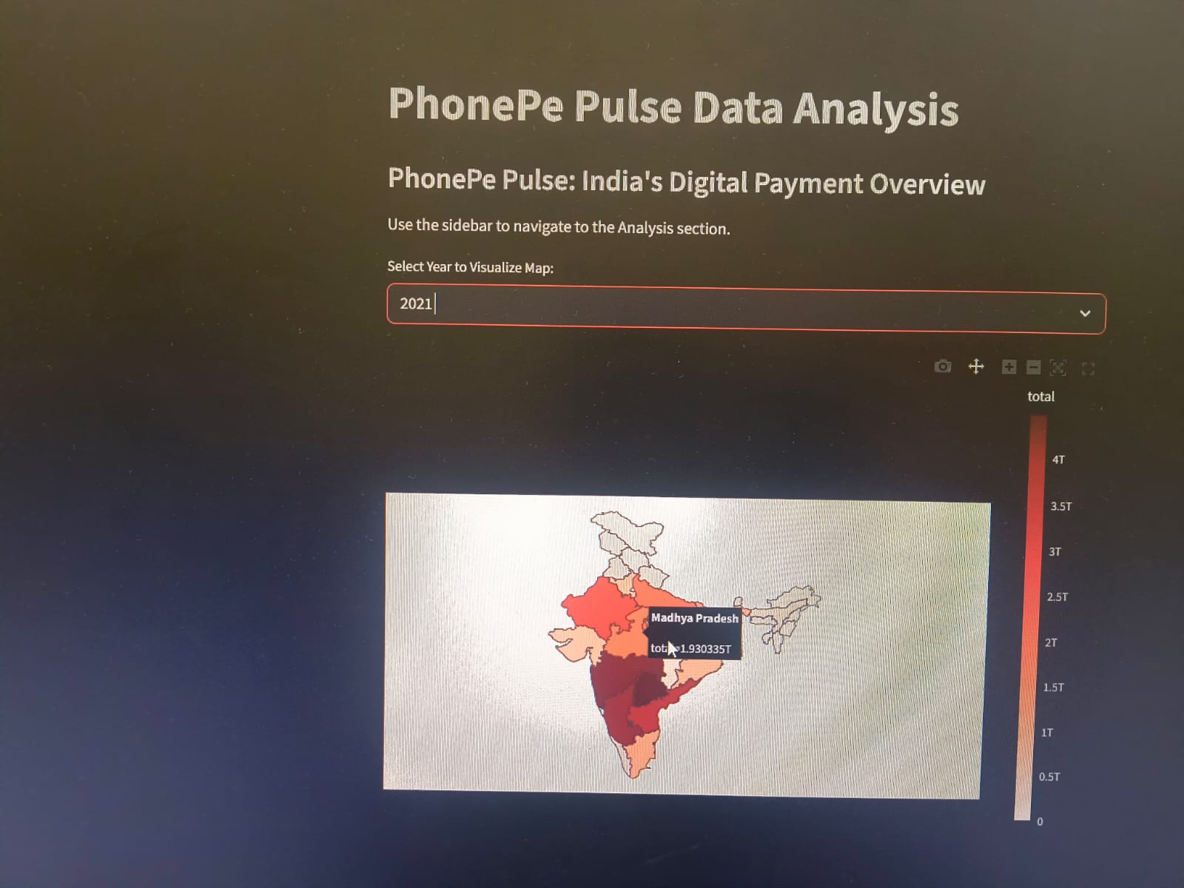
Interactive Choropleth Map of India.

Slide 6
Data Pipeline
Step 1: Data Extraction: Cloned GitHub data and parsed nested JSON files using Python.
Step 2: Database Migration: Successfully uploaded clean data into 12 SQL tables (Aggregated, Map, and Top tables).
Step 3: Analysis: Performed SQL queries to identify top-performing states and payment categories.
Step 4: Dashboarding: Integrated Python and SQL to display insights dynamically.

Slide 7
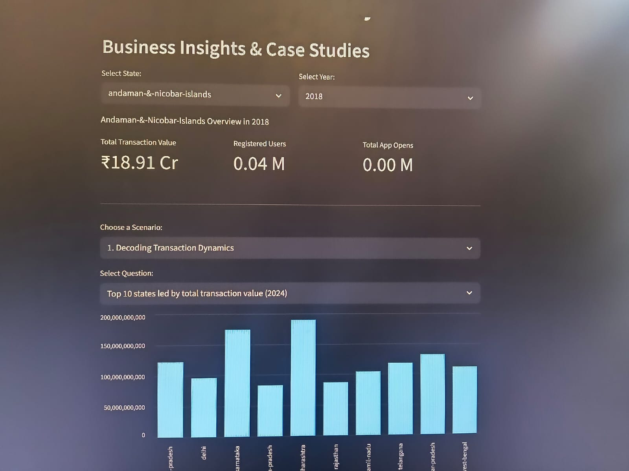
TOTAL TRANSACTION VALUE(TOP 10 STATES)

Slide 8
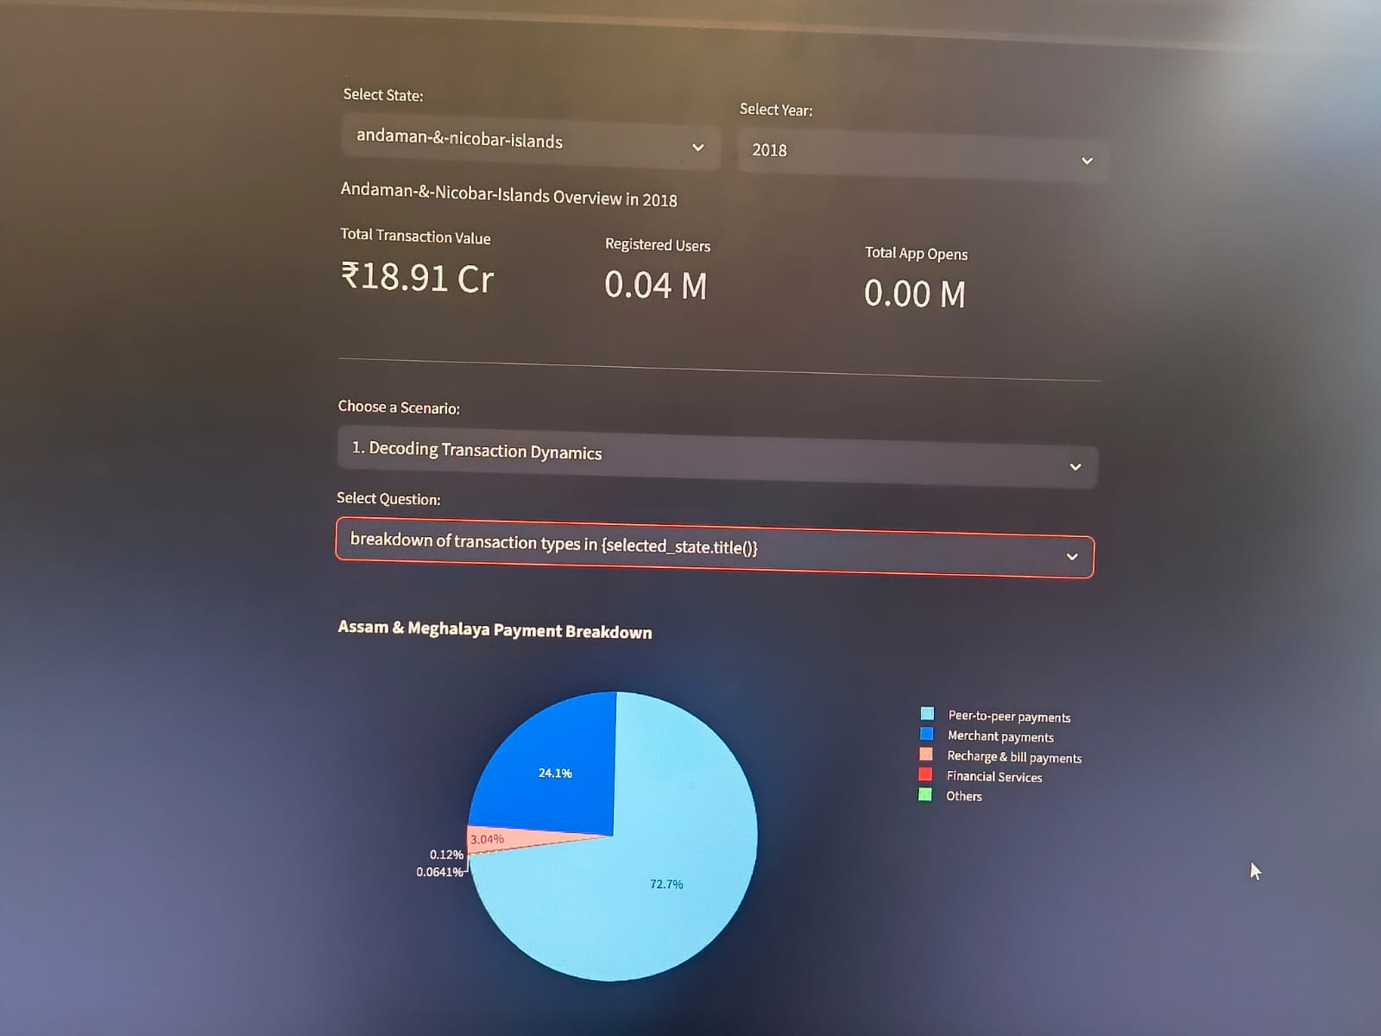
TRANSACTION TYPES

Slide 9
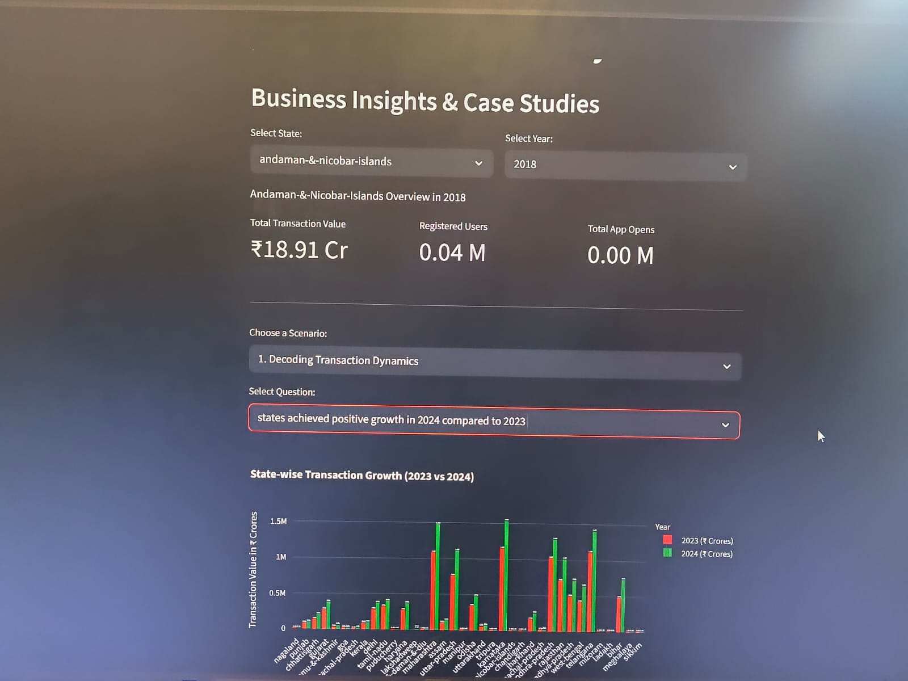
GROWTH IN 2024 COMPARED TO 2023

Slide 10
Key Business Insights
Geographical Dominance: Southern India (Karnataka, Telangana) leads in total transaction value, while rural areas show high user registration growth.
Payment Trends: Peer-to-Peer (P2P) transfers remain the volume leader, but Merchant Payments show massive spikes during Q3/Q4 festive seasons.
Product Opportunity: Insurance transaction data shows low penetration in Tier 3 cities—this represents a major market for Micro-insurance products.

Slide 11
Actionable Recommendations
Marketing Optimization: Target "High Engagement, Low Transaction" districts with cashback incentives to convert users into active payers.
Infrastructure Investment: Scale server capacity in high-growth districts identified in the "Top Pincodes" analysis.
Service Expansion: Use "Map User" data to identify regions ready for new fintech features like Lending or Fixed Deposits.

Slide 12
Project Conclusion & Repository Access
Key Takeaways:
  Successfully processed 2,000+ JSON files into a structured PostgreSQL database.
  Developed an interactive Streamlit dashboard for real-time finance insights.
  Gained proficiency in the ETL (Extract, Transform, Load) pipeline.
Final Deliverables:
  Python Source Code (app.py & extraction.ipynb)
  SQL Database Schema
  Interactive Visualizations
Project Link:
https://github.com/sumathy711/PhonePe-Pulse-Project

Slide 13
Thank You!
"I appreciate your time and attention. I am now open to any questions regarding the data extraction, SQL logic, or dashboard insights."
"I appreciate your time and attention. I am now open to any questions regarding the data extraction, SQL logic, or dashboard insights."
J. SUMATHI GURUNATHAN
GitHub Link:
https://github.com/sumathy711/PhonePe-Pulse-Project
"I appreciate your time and attention. I am now open to any questions regarding the data extraction, SQL logic, or dashboard insights."

